Slide 1
Operating Systems (COS 101)
Week 3

Slide 2
Learning Objectives
What is an Operating System, Types and Function?
Characteristics of an OS
Difference between 32-bit and 64-bit OS
CPU Scheduling
Semaphores in OS
Deadlocks
Components of an OS
Processes and Threads
Multitasking, Multithreading & Multiprocessing
Compilers and Interpreters

Slide 3
What is an Operating System (OS)?
An operating system acts as an intermediary between the user of a computer and computer hardware.
It is an interface between computer hardware and user.
The purpose of an operating system is to provide an environment in which a user can execute programs conveniently and efficiently.

Slide 4
Types of Operating Systems?
Batch OS
Multi-programmed OS
Timesharing OS
Real-Time OS
Distributed OS
(e.g. Transactions Process, Payroll System, etc.)
(e.g. Windows, UNIX, macOS, etc.)
(e.g. Multics, Linux, etc.)
(e.g. PSOS, VRTX, etc.)
(e.g. LOCUS, Solaris, etc.)

Slide 5
Functions of Operating Systems?
Resource Management:
Process Management:
Storage Management:
Memory Management:
Security/Privacy Management:
When multiple users are accessing the system, the OS works as a Resource Manager. Its responsibility is to provide hardware to the user. It decreases the load in the system.
It includes various tasks like scheduling and termination of the process. It is done with the help of CPU Scheduling algorithms .
The file system mechanism used for the management of the storage. All the data is stored in various tracks of Hard disks that are all managed by the storage manager. It includes the Hard Disk .
The operating system has to keep track of how much memory has been used and by whom. It has to decide which process needs memory space and how much. OS also has to allocate and deallocate the memory space.
Privacy is also provided by the Operating system using passwords so that unauthorized applications can’t access programs or data. For example, Windows uses Kerberos authentication to prevent unauthorized access to data.

Slide 6
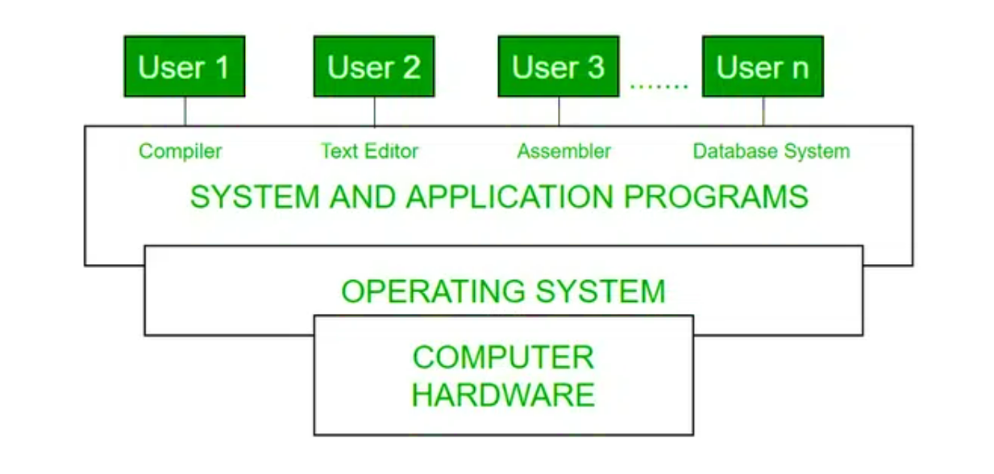
Conceptual View of a Computer

Slide 7
Characteristics of an OS
Virtualization
Networking
Scheduling
Performance Monitoring
Backup & Recovery
Debugging

Slide 8
Shell & Kernel in an OS
The shell is a command-line interface that allows the user to enter commands to interact with the operating system. It acts as an intermediary between the user and the kernel, interpreting commands entered by the user and translating them into instructions that the kernel can execute. The shell also provides various features like command history, tab completion, and scripting capabilities to make it easier for the user to work with the system.
The kernel is the core component of the operating system that manages system resources and provides services to other programs running on the system. It acts as a bridge between the user and the resources of the system by accessing various computer resources like the CPU, I/O devices and other resources. It is responsible for tasks such as memory management, process scheduling, and device drivers.
The kernel operates at a lower level than the shell and interacts directly with the hardware of the computer.

Slide 9
Components of an OS
Process Management
File Management
Network Management
Main Memory Management
Secondary Storage Management
I/O Device Management
Security Management
Command Interpreter System

Slide 10
Difference Between 32-Bit and 64-Bit OS
32-bit
64-bit

Slide 11
32-bit vs 64-bit OS
32-Bit Operating System | 64-Bit Operating System
32-bit OS is required for running of 32-bit Processors, as they are not capable of running on 64-bit processors. | 64-Bit Processors can run on any of the Operating Systems, like 32-Bit OS or 64-Bit OS.
32-Bit OS gives a low efficient performance. | 64-Bit Operating System provides highly efficient Performance.
Less amount of data is managed in 32-Bit Operating System as compared to 64-Bit Os. | A large amount of data can be stored in 64-Bit Operating System.
32-Bit Operating System can address 2^32 bytes of RAM. | 64-Bit Operating System can address 2^64 bytes of RAM.

Slide 12
Compilers and Interpreters in OS
Compilers
Interpreters

Slide 13
What is a Compiler?
A compiler is a program that translates a source program written in some high-level programming language (such as Java) into machine code for some computer architecture (format of 0s and 1s).
The work of a compiler is to transform the codes written in the programming language into machine code so that computers can understand.
The compiler's run time is longer and occupies a larger part of memory. It has a slow speed because a compiler goes through the entire program and then translates the entire program into machine codes.

Slide 14
What is an Interpreter?
An interpreter directly executes instructions written in a programming language without requiring them previously to have been compiled into a machine language program.
An interpreter is a computer program that is used to directly execute program instructions written using one of the many high-level programming languages.
The interpreter transforms the high-level program into an intermediate language that it executes, or it could parse the high-level source code and perform the commands directly, which is done line by line or statement by statement.

Slide 15
Process and Threads in OS
Process and threads are the basic components in OS.
Process is the program under execution whereas the thread is part of process.
Threads of a process can be used when same process is required multiple times. A process can consists of multiple threads.

Slide 16
Difference Between Multitasking, Multithreading and Multiprocessing
Multitasking
Multiprocessing
Multithreading

Slide 17
What is Multitasking?
Multi tasking operating systems allow multiple users to perform multiple tasks at the same time.
The allocation of system resources such as input/output devices, CPU and memory among processes can be easily managed by multi-tasking operating system.
There are various states through which a processor passes to complete particular or multiple executions.
Multitasking is the ability of an OS to execute more than one task simultaneously on a CPU machine as shown in the below diagram.

Slide 18
What is Multithreading?
Multi-threading is an execution model that allows a single process to have multiple code segments (i.e., threads) running concurrently within the “context” of that process.
E.g. VLC media player, where one thread is used for opening the VLC media player, one thread for playing a particular song and another thread for adding new songs to the playlist.
Multi threading is the ability of a process to manage its use by more than one user at a time and to manage multiple requests by the same user without having to have multiple copies of the program.
The main advantage of Multi threading is increase responsiveness. Since there are multiple threads in a program, so if one thread is taking too long to execute or if it gets blocked, the rest of the threads keep executing without any problem.

Slide 19
What is Multiprocessing?
Multiprocessing is the use of two or more CPUs (processors) within a single Computer system.
The term also refers to the ability of a system to support more than one processor within a single computer system.
Since there are multiple processors available, multiple processes can be executed at a time.
The main advantage of a multiprocessor system is to get more work done in a shorter period of time.

Slide 20
CPU Scheduling in OS
CPU Scheduling is a process that allows one process to use the CPU while another process is delayed (in standby) due to unavailability of any resources such as I/O etc.
The purpose of CPU Scheduling is to make the system more efficient, faster, and fairer.
It is a key part of how an operating system works because it decides which task (or process) the CPU should work on at any given time.
This is important because a CPU can only handle one task at a time, but there are usually many tasks that need to be processed.

Slide 21
Process Synchronization in OS
Process synchronization is the process of coordination or multiple processes or threads that share common resources to execute and prevent conflicts between the processes or do not interfere with each other while sharing resources and ensuring data consistency.
It’s essential in multi-threaded or multi-process systems where concurrent access to shared resources can lead to issues like deadlocks, and inconsistencies.

Slide 22
Semaphores in OS
Semaphore is a mechanism or tool used in OS to help manage how different processes (or programs) share resources, like memory or data, without causing conflicts.
A semaphore is a special kind of synchronization data that can be used only through specific synchronization primitives.
Semaphores are used to implement critical sections, which are regions of code that must be executed by only one process at a time.
By using semaphores, processes can coordinate access to shared resources, such as shared memory or I/O devices.

Slide 23
Deadlocks in OS
A deadlock is a situation where a set of processes is blocked because each process is holding a resource and waiting for another resource acquired by some other process.
Consider an example when two trains are coming toward each other on the same track and there is only one track, none of the trains can move once they are in front of each other. This is a practical example of deadlock.
Key concepts include mutual exclusion, resource holding, circular wait, and no preemption.

